Slide 1
Qualitative Research: Methodologies?

Slide 2
Qualitative Research: Are you in or out?
Honesty in the Caring Professions: Constructs and Life Stories of Selected Caring Professionals in Davao City
Cancer Treatment in Everyday Life: Rituals and Social Networks in an Oncology Department
Patient Involvement in Healthcare: A Systematic Grounded Theory
Having Mentally Handicapped Family Members: Conditions, Struggles and Sources of Hope of Selected Families
The Evolution of the RHRDCXI’s Vision and Mission: Stories and Perspectives from the Prime Movers
Empowering Communities through Participatory Healthcare: Multi-Sectoral Perspectives on Efficiency, Efficacy and Sustainability

Slide 3
Reality Check: Guilty as charged?
Qualitative research is typically viewed as a research technique that complements mainstreamed quantitative methodologies.
Researchers tend to teach qualitative research as a generic methodology that is devoid of variety.
In the absence of specialists or practitioners in the field, students are forced to ‘quantitize’ topics that are more suitable for a qualitative approach.
The philosophical foundations of scientific research are ignored given that qualitative and quantitative research are understood as methodologies.
Quantitative standards are used to evaluate the ‘quality’ of qualitative researches.

Slide 4
Before we start: Big QUESTIONS
What is qualitative research?
What are the differences between quantitative and qualitative research?
Is qualitative research a mere technique or method in accomplishing a scientific task?
What are the major qualitative research traditions?
When to use a specific qualitative research tradition?

Slide 5
What is SCIENCE?
“Science is the systematic enterprise of gathering knowledge about the universe and organizing and condensing that knowledge into testable laws and theories” (American Physical Society, 1999).
“Science is the pursuit and application of knowledge and understanding of the natural and social world following a systematic methodology based on evidence” (British Science Council).

Slide 6
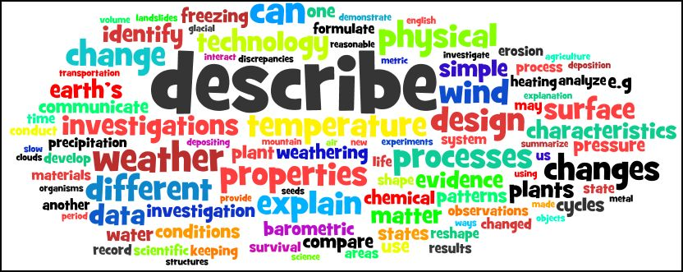
Thus, mainstream science believes that…
Realities are objects
Realities are explainable
Regularities can be established
The knower must be objective
Realities are measurable
Conformity to defined steps and procedures is a must

Slide 7
Reactions to ‘mainstream’ science: Reflections and Realizations
Realities are interpreted (meanings are assigned)
Realities are fluid/emergent
Inquiry is political
Realities are dynamic and hard to measure
Methods must be flexible in order to capture the dynamic character of realities

Slide 8
What constitutes legitimate science?
Interpretation
Subjective-reflexive stance
Exploratory
Emergent
Understand realities as they are (interpreted)
Active Involvement
Objective Existence
Objective stance
Theory testing
Structure
Quantification
Passivity

Slide 9
Science is…
Paradigmatic…anchored on certain crisscrossing philosophical and theoretical frames.

Slide 10
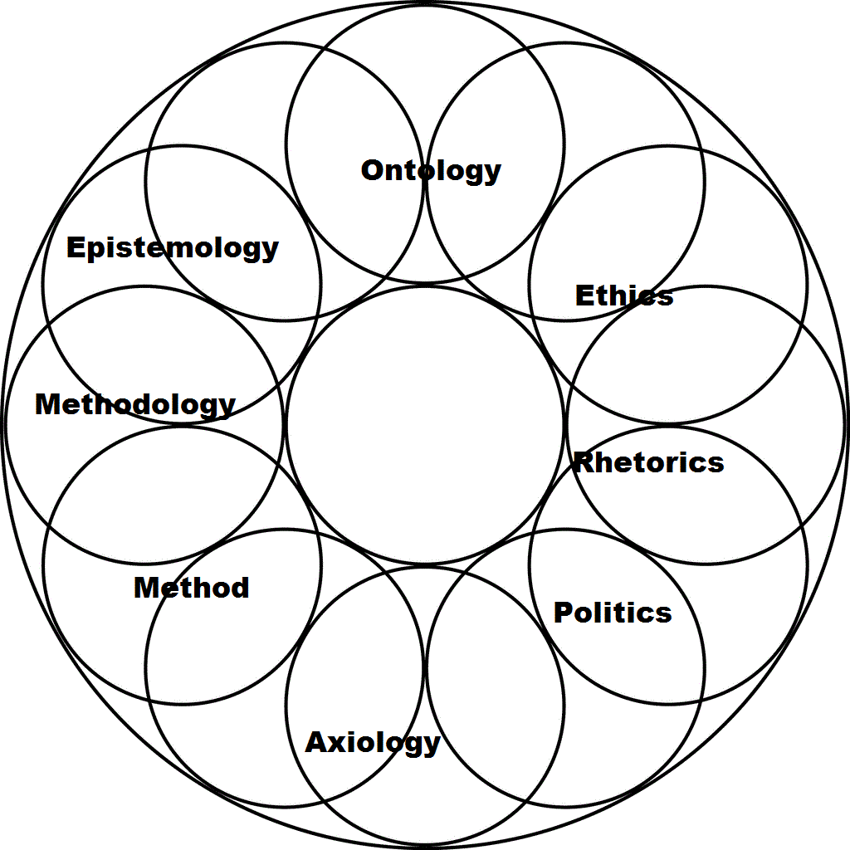

Slide 11
What is correct science? What is correct scientific research? COMPETING ORIENTATIONS IN SCIENCE
Positivism
Interpretivism

Slide 12
The Positivist and Interpretivist Divide (1)
Positivism
Interpretivism
Knowledge is based on phenomena that is directly observable
The world should be researched using the principles of natural science (such as experiments)
There is a stress on reliability and generalisability
Knowledge is based on understanding interpretations and meanings that are not directly observable
The world should be studied in its natural state (using participant observation and depth interviews) to understand naturally occurring behavior
There is a stress on validity

Slide 13
The Positivist and Interpretivist Divide (2)
Positivism
Interpretivism
Explanation is achieved through the formulation of causal laws or law-like generalizations (nomothetic approach)
There is use of the hypothetico-deductive method in which there is an emphasis on testing given theory
Explanation is achieved through descriptions of social meanings/reasons and other dispositions to action (idiographic approach)
There is use of the analytic-inductive method in which theory is generated from the data
Notes:
Nomothetic—search for abstract universal principles
Idiographic—focus is on individuals

Slide 14
The Positivist and Interpretivist Divide (3)
Positivism
Interpretivism
Methods imply researcher/respondent detachment in the objective collection of data
Analysis is based on the statistical testing of given theories
Methods imply insider approach—participation in life and culture of respondent/closeness of respondent and researcher in the joint construction of subjective data
Analysis is based on verbal, action and situation description from which theory evolves

Slide 15
Overarching Research Paradigms

Slide 16
What is qualitative research?
“Qualitative research is a means for exploring and understanding the meaning individuals or groups ascribe to a social or human problem. The process of research involves emerging questions and procedures, data typically collected in the participant’s setting, data analysis inductively building from particulars to general themes, and the researcher making interpretations of the meaning of the data. The final written report has a flexible structure. Those who engage in this form of inquiry support a way of looking at research that honors an inductive style, a focus on individual meaning, and the importance of rendering the complexity of a situation” (Creswell, 2007).

Slide 17
What is Qualitative Research?
“A qualitative approach is one in which the inquirer often makes knowledge claims based primarily on constructivist perspectives (i.e. the multiple meanings of individual experiences, meanings socially and historically constructed, with an intent of developing a theory or pattern) or advocacy/participatory perspectives (i.e. political, issue-oriented, collaborative or change oriented) or both” (Creswell, 2003).

Slide 18
Unlike most quantitative research, qualitative research typically doesn’t…
Measure. (Ex: “What is the rate of graduation?”)
Produce a quantified product (Ex: “86% of our students are satisfied with their learning experience.”)
Seek to establish a causal relationship. (Ex: “Summer attendance shortens time to degree.”)

Slide 19
Assumptions Underlying Qualitative Methods (CNHRI Resources, n.d.)
multiple realities exist in any given situation -- the researcher’s, those of the individuals being investigated, and the reader or audience interpreting the results; these multiple perspectives, or voices, of informants (i.e., subjects) are included in the study;
the researcher interacts with those he studies and actively works to minimize the distance between the researcher and those being researched;
the researcher explicitly recognizes and acknowledges the value-laden nature of the research;
research is context-bound;
research is based on inductive forms of logic; categories of interest emerge from informants (subjects), rather than being identified a priori by the researcher;
the goal is to uncover and discover patterns or theories that help explain a phenomenon of interest; and
determinations of accuracy involve verifying the information with informants or "triangulating" among different sources of information (e.g., collecting information from different sources).

Slide 20
Characteristics of Quantitative and Qualitative Research in the Process of Research
Quantitative Characteristics
Steps in the Research Process
Qualitative Characteristics
Description of trends and
Explanation Oriented
Identifying a Problem
Exploratory/ Understanding
a Central Phenomena
Major Role
Justify Problem
Reviewing the Literature
Minor Role
Justify Problem
Specific and Narrow
Measurable/Observable
Specifying a Purpose
General and Broad
Participants’ Experience
Pre-determined Instruments
Numeric Data
Large numbers
Emerging Protocols
Text or image data
Small Number
Collecting Data
Statistical
Description of Trends
Comparisons/Predictions
Analyze and Interpret Data
Text Analysis
Description/Themes
Larger meanings of findings
Standard and Fixed
Objective and Unbiased
Report and Evaluate
Flexible and Emerging
Reflexive and Biased

Slide 21
Overall differences
Quantitative
Qualitative
Objective:
to quantify sample findings and generalize these results to the population of interest
Nature of Data:
mostly numerical
Sample:
large number of representative cases
Data Collection:
highly structured, standardized
Data Analysis:
statistical
Outcome:
recommend a final course of action
Objective:
to gain a deeper understanding of behaviors, inner thoughts & feelings, and meanings
Nature of Data:
“soft data” such as words, audio, pictures, film
Sample:
small samples, often judgment sampling
Data Collection:
unstructured or semi-structured
Data Analysis:
data synthesis, interpretation, themes
Outcome:
develop an initial or deeper understanding

Slide 22
When to use qualitative research? When the research topic is…
Sensitive
Complicated
Non-measurable
Concerned with interaction and/or process

Slide 23
How am I going to accomplish qualitative research? Some QUESTIONS that need resolutions
Is the topic suitable for qualitative research?
Do you adhere to the ontological and epistemological assumptions of qualitative inquiry?
What is the study all about? What are your goals?
Do you intend to study experiences or generate a theory?
Are you coming from a particular frame of thinking or you want to capture emergent frames?

Slide 24
Qualitative Research: Approaches and Techniques
Phenomenology
Ethnography
Case Study
Grounded Theory
Participant Observation
Interviews
Review of Documents or AV Materials
Analysis of Secondary Data
Unobtrusive Measures
Constant Comparison Technique
Thematic Network Analysis
Word Counting

Slide 25
When to use a specific approach?
Phenomenology
"The purpose of the phenomenological approach is to illuminate the specific, to identify phenomena through how they are perceived by the actors in a situation" (Lester, 1999).
Ethnography
Ethnography refers to the process of collecting primary data through fieldwork (participant observation) about a culture-sharing group with emphasis on a particular cultural parameter. The end-goal of this process is the production of vivid (written) accounts of the cultural parameter as a lived experience of the participants or agents of the culture-sharing group.
Case Study
Grounded Theory
Qualitative case study is a research design that seeks to understand a phenomenon or a set of phenomena utilizing various sources of data. It is either descriptive or exploratory in purpose with an overarching goal of generating a conceptual framework that allows understanding of the case or cases of interest.
‘the discovery of theory from data systematically obtained from social research’ (Glaser and Strauss 1967: 2)

Slide 26
Phenomenology
Phenomenon, Descriptions of the phenomenon as experienced or interpretation of the experience
Ethnography
Cultural Theme, Culture-sharing group, Participant Observation/Fieldwork,
Product: Ethnography that locates the cultural theme in the overall cultural system(s)
Product: Properties of people’s experiences or interpretations

Slide 27
Case Study
Case(s), Context (Conditions), Propositions, Levels Conceptual Frame, Levels of Analysis
Product: An Emergent Conceptual Frame that Describes the Case(s)
Grounded Theory
Substantive Process to theorize, Coding (depends on GT approach)
Product: Core Category and the Grounded Theory

Slide 28
How do doctors experience and perceive the medical profession?
What are the interconnections of caring rituals of nurses in a burn unit?
What are the facets of an oncology department that shape patients’ decision to undergo cancer treatment?
(Why and…) How do patients participate in the conceptualization of their respective treatment regimens?

Slide 29
End of presentation
Thank you for listening!

